Slide 1
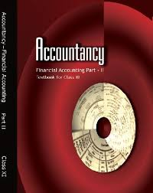
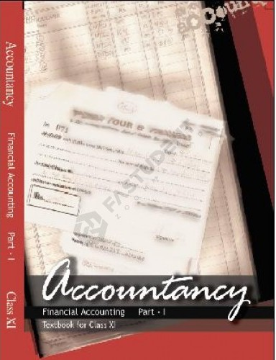
Class XI
Accountancy
Part - 2
Part - 1

Slide 2
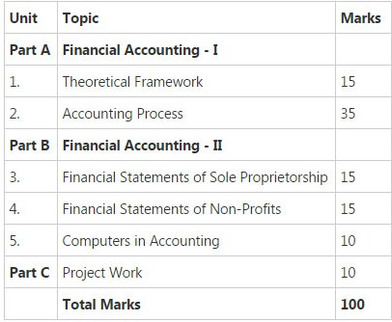
Course S structure

Slide 3
Unit - 1
THEORETICAL FRAMEWORK
Points to be Covered
Accounting concepts, objectives, advantages and limitations
Basic Accounting Terms
Fundamental Accounting
Assumptions and principles
Accounting Standards and IFRS
Double entry System of Accounting

Slide 4
Unit - 2
ACCOUNTING PROCESS
Points to be Covered
Recording of Transactions
Preparation of Bank Reconciliation statement, Ledgers, and Trial Balance
Depreciation, Provision and Reserves
Accounting for Bills of Exchange
Rectification of Errors

Slide 5
Unit - 3
FINANCIAL STATEMENTS OF SOLE PROPRIETORSHIP
Points to be Covered
Financial Statements without Adjustments
Financial Statements with Adjustments
Accounts from Incomplete Records

Slide 6
Unit - 4
FINANCIAL STATEMENTS OF NOT-FOR- PROFIT ORGANISATIONS
Unit - 5
COMPUTERS IN ACCOUNTING

Slide 7
Unit - 6
COMPREHENSIVE PROJECT

Slide 8
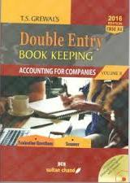
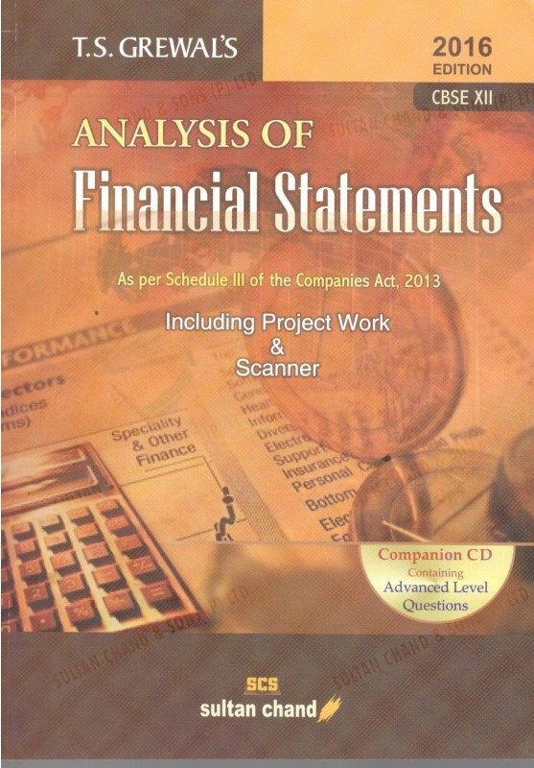
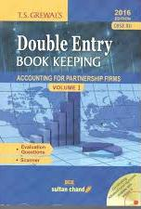
CLASS XII - TEXTBOOK

Slide 9
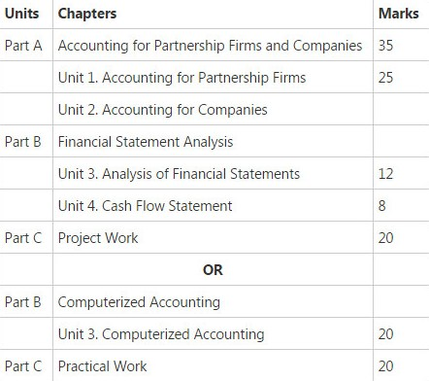
Course S structure

Slide 10
Part-A - ACCOUNTING FOR PARTNERSHIP FIRMS AND COMPANIES
Unit - 1
ACCOUNTING FOR PARTNERSHIP FIRMS
Points to be Covered
Fundamentals, and Goodwill treatment
Change in profit sharing ratio
Admission of a partner
Retirement and Death of a Partner
Dissolution of partnership Firm

Slide 11
Unit - 2
ACCOUNTING FOR COMPANIES
Points to be Covered
Accounting for Share Capital
Accounting for Debentures

Slide 12
Part-B - FINANCIAL STATEMENT ANALYSIS
Unit - 3
ANALYSIS OF FINANCIAL STATEMENTS
Points to be Covered
Financial Statements of a Company
Financial Statement Analysis
Accounting Ratios

Slide 13
Unit -4
CASH FLOW STATEMENT

Slide 14
Unit - 6
COMPREHENSIVE PROJECT
CBSE GUIDELINES FOR PROJECT WORK
UNIT 1: PROJECT FILE 4 MARK
( ONE COMPREHENSIVE PROJECT
AND 2 SPECIFIC PROJECTS)
UNIT 2: WRITTEN TEST ( 1 HOUR) 12 MARKS
UNIT 3 VIVA VOCE 4 MARKS
TOTAL MARKS 20 MARKS

Slide 15
THANK YOU
Anjana Naik

